Slide 1
Measurement, Understanding, Description
Week 2

Slide 2
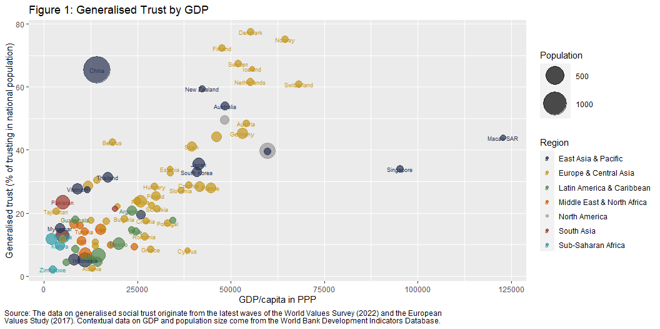

Slide 3
Working in R and RStudio

Slide 4

こんにちは、私の名前は です。
A statistical programming language
A language called S is developed at Bell Labs (USA) in 1976
The R language created as a free open source implementation of S in 1991 at the University of Auckland (NZ); it developed into a different “dialect” of the original language S
R goes public in 1993, a core maintainer group is set up in 1997, and Version 1.0.0 is released in 2000
Current stable, released version (2023-10-03) is R-4.3.1 (2023-06-16, “Beagle Scouts”); minor releases about 4/5 times a year; mid-version releases about once a year; major releases every 7/8 years

Slide 5
こんにちは、私の名前は です。
A statistical programming language
A language called S is developed at Bell Labs (USA) in 1976
The R language created as a free open source implementation of S in 1991 at the University of Auckland (NZ); it developed into a different “dialect” of the original language S
R goes public in 1993, a core maintainer group is set up in 1997, and Version 1.0.0 is released in 2000
Current stable, released version (2023-10-03) is R-4.3.1 (2023-06-16, “Beagle Scouts”); minor releases about 4/5 times a year; mid-version releases about once a year; major releases every 7/8 years
Computer commands as speech acts

Slide 6

RStudio: “But I’m here to help!”
An Integrated Development Interface (IDE)
Company founded in 2009 in Boston (MA, USA) to develop open source and enterprise-ready professional software for the R statistical computing environment
First public beta version (v0.92) of the RStudio IDE came out in 2011; Version 1 released in 2016; latest version (on 2023-10-03) is Version: 2023.09.0+463, released: 2023-09-28
In 2022 the company changes its name to Posit PBC in a move to be seen as more language-agnostic and embrace other programming languages too (Python, Julia, etc.). RStudio lives on as an IDE

Slide 7
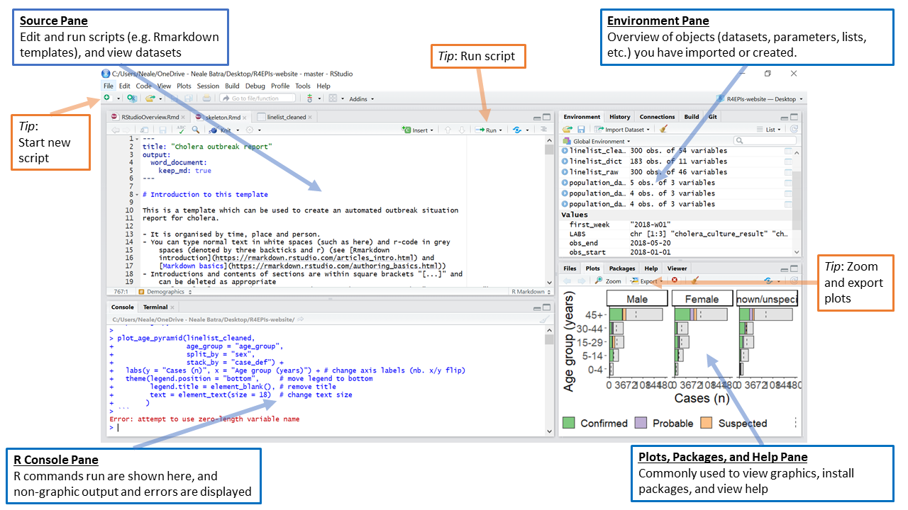
The RStudio interface

Slide 8
Other essential tools we will use
R packages
What’s a “package”?
A collection of functions and data aimed to perform specific tasks
What’s a “function”?

Slide 9
Functions
Example:
Chris_s_mean <- function(number1, number2) { mean_value <- (number1 + number2) / 2 print(paste("The mean of", number1, "and", number2, "is", mean_value)) }

Slide 10
Functions
Example:
Chris_s_mean <- function(number1, number2) { mean_value <- (number1 + number2) / 2 print(paste("The mean of", number1, "and", number2, "is", mean_value)) }
Chris_s_mean(2, 8)

Slide 11
Functions
Example:
Chris_s_mean <- function(number1, number2) { mean_value <- (number1 + number2) / 2 print(paste("The mean of", number1, "and", number2, "is", mean_value)) }
Chris_s_mean(2, 8)
[1] "The mean of 2 and 8 is 5"

Slide 12
Functions
Example:
Chris_s_mean(2, 8)
[1] "The mean of 2 and 8 is 5"

Slide 13
Functions
Example:
Chris_s_mean(2, 8)
[1] "The mean of 2 and 8 is 5"
Chris_s_mean(7, 9)

Slide 14
Functions
Example:
Chris_s_mean(2, 8)
[1] "The mean of 2 and 8 is 5"
Chris_s_mean(7, 9)
[1] "The mean of 7 and 9 is 8"

Slide 15
Functions
Example:
Chris_s_mean(2, 8)
[1] "The mean of 2 and 8 is 5"
Chris_s_mean(7, 9)
[1] "The mean of 7 and 9 is 8"
Chris_s_mean(461325, 7849545)

Slide 16
Functions
Example:
Chris_s_mean(2, 8)
[1] "The mean of 2 and 8 is 5"
Chris_s_mean(7, 9)
[1] "The mean of 7 and 9 is 8"
Chris_s_mean(461325, 7849545)
[1] "The mean of 461325 and 7849545 is 4155435"

Slide 17
Functions
Example:
Chris_s_mean(2, 8)
[1] "The mean of 2 and 8 is 5"
Chris_s_mean(7, 9)
[1] "The mean of 7 and 9 is 8"
Chris_s_mean(461325, 7849545)
[1] "The mean of 461325 and 7849545 is 4155435"
Chris_s_mean(1, 2, 3)

Slide 18
Functions
Example:
Chris_s_mean(2, 8)
[1] "The mean of 2 and 8 is 5"
Chris_s_mean(7, 9)
[1] "The mean of 7 and 9 is 8"
Chris_s_mean(461325, 7849545)
[1] "The mean of 461325 and 7849545 is 4155435"
Chris_s_mean(1, 2, 3)
Error in Chris_s_mean(1, 2, 3): unused argument (3)

Slide 19
Functions
What if we want more?
Chris_s_mean <- function(...) { numbers <- c(...) mean_value <- mean(numbers) print(ifelse(length(numbers) > 2, paste("The mean of the numbers is", mean_value), paste("The mean of", numbers[1], "and", numbers[2], "is", mean_value)) ) }

Slide 20
Functions
What if we want more?
Chris_s_mean <- function(...) { numbers <- c(...) mean_value <- mean(numbers) print(ifelse(length(numbers) > 2, paste("The mean of the numbers is", mean_value), paste("The mean of", numbers[1], "and", numbers[2], "is", mean_value)) ) }
Chris_s_mean(1, 2, 3)

Slide 21
Functions
What if we want more?
Chris_s_mean <- function(...) { numbers <- c(...) mean_value <- mean(numbers) print(ifelse(length(numbers) > 2, paste("The mean of the numbers is", mean_value), paste("The mean of", numbers[1], "and", numbers[2], "is", mean_value)) ) }
Chris_s_mean(1, 2, 3)
[1] "The mean of the numbers is 2"

Slide 22
Functions
What if we want more?
Chris_s_mean <- function(...) { numbers <- c(...) mean_value <- mean(numbers) print(ifelse(length(numbers) > 2, paste("The mean of the numbers is", mean_value), paste("The mean of", numbers[1], "and", numbers[2], "is", mean_value)) ) }
Chris_s_mean(1, 2, 3)
[1] "The mean of the numbers is 2"
Chris_s_mean(9, 23)

Slide 23
Functions
What if we want more?
Chris_s_mean <- function(...) { numbers <- c(...) mean_value <- mean(numbers) print(ifelse(length(numbers) > 2, paste("The mean of the numbers is", mean_value), paste("The mean of", numbers[1], "and", numbers[2], "is", mean_value)) ) }
Chris_s_mean(1, 2, 3)
[1] "The mean of the numbers is 2"
Chris_s_mean(9, 23)
[1] "The mean of 9 and 23 is 16"

Slide 24
Functions
What if we want more?
Chris_s_mean <- function(...) { numbers <- c(...) mean_value <- mean(numbers) print(ifelse(length(numbers) > 2, paste("The mean of the numbers is", mean_value), paste("The mean of", numbers[1], "and", numbers[2], "is", mean_value)) ) }
Chris_s_mean(1, 2, 3)
[1] "The mean of the numbers is 2"
Chris_s_mean(9, 23)
[1] "The mean of 9 and 23 is 16"
Chris_s_mean(4:400)

Slide 25
Functions
What if we want more?
Chris_s_mean <- function(...) { numbers <- c(...) mean_value <- mean(numbers) print(ifelse(length(numbers) > 2, paste("The mean of the numbers is", mean_value), paste("The mean of", numbers[1], "and", numbers[2], "is", mean_value)) ) }
Chris_s_mean(1, 2, 3)
[1] "The mean of the numbers is 2"
Chris_s_mean(9, 23)
[1] "The mean of 9 and 23 is 16"
Chris_s_mean(4:400)
[1] "The mean of the numbers is 202"

Slide 26
Other essential tools we will use
R packages
tidyverse
dplyr
…
easystats
datawizard
…
ggplot2
ggformula
gtsummary
…

Slide 27
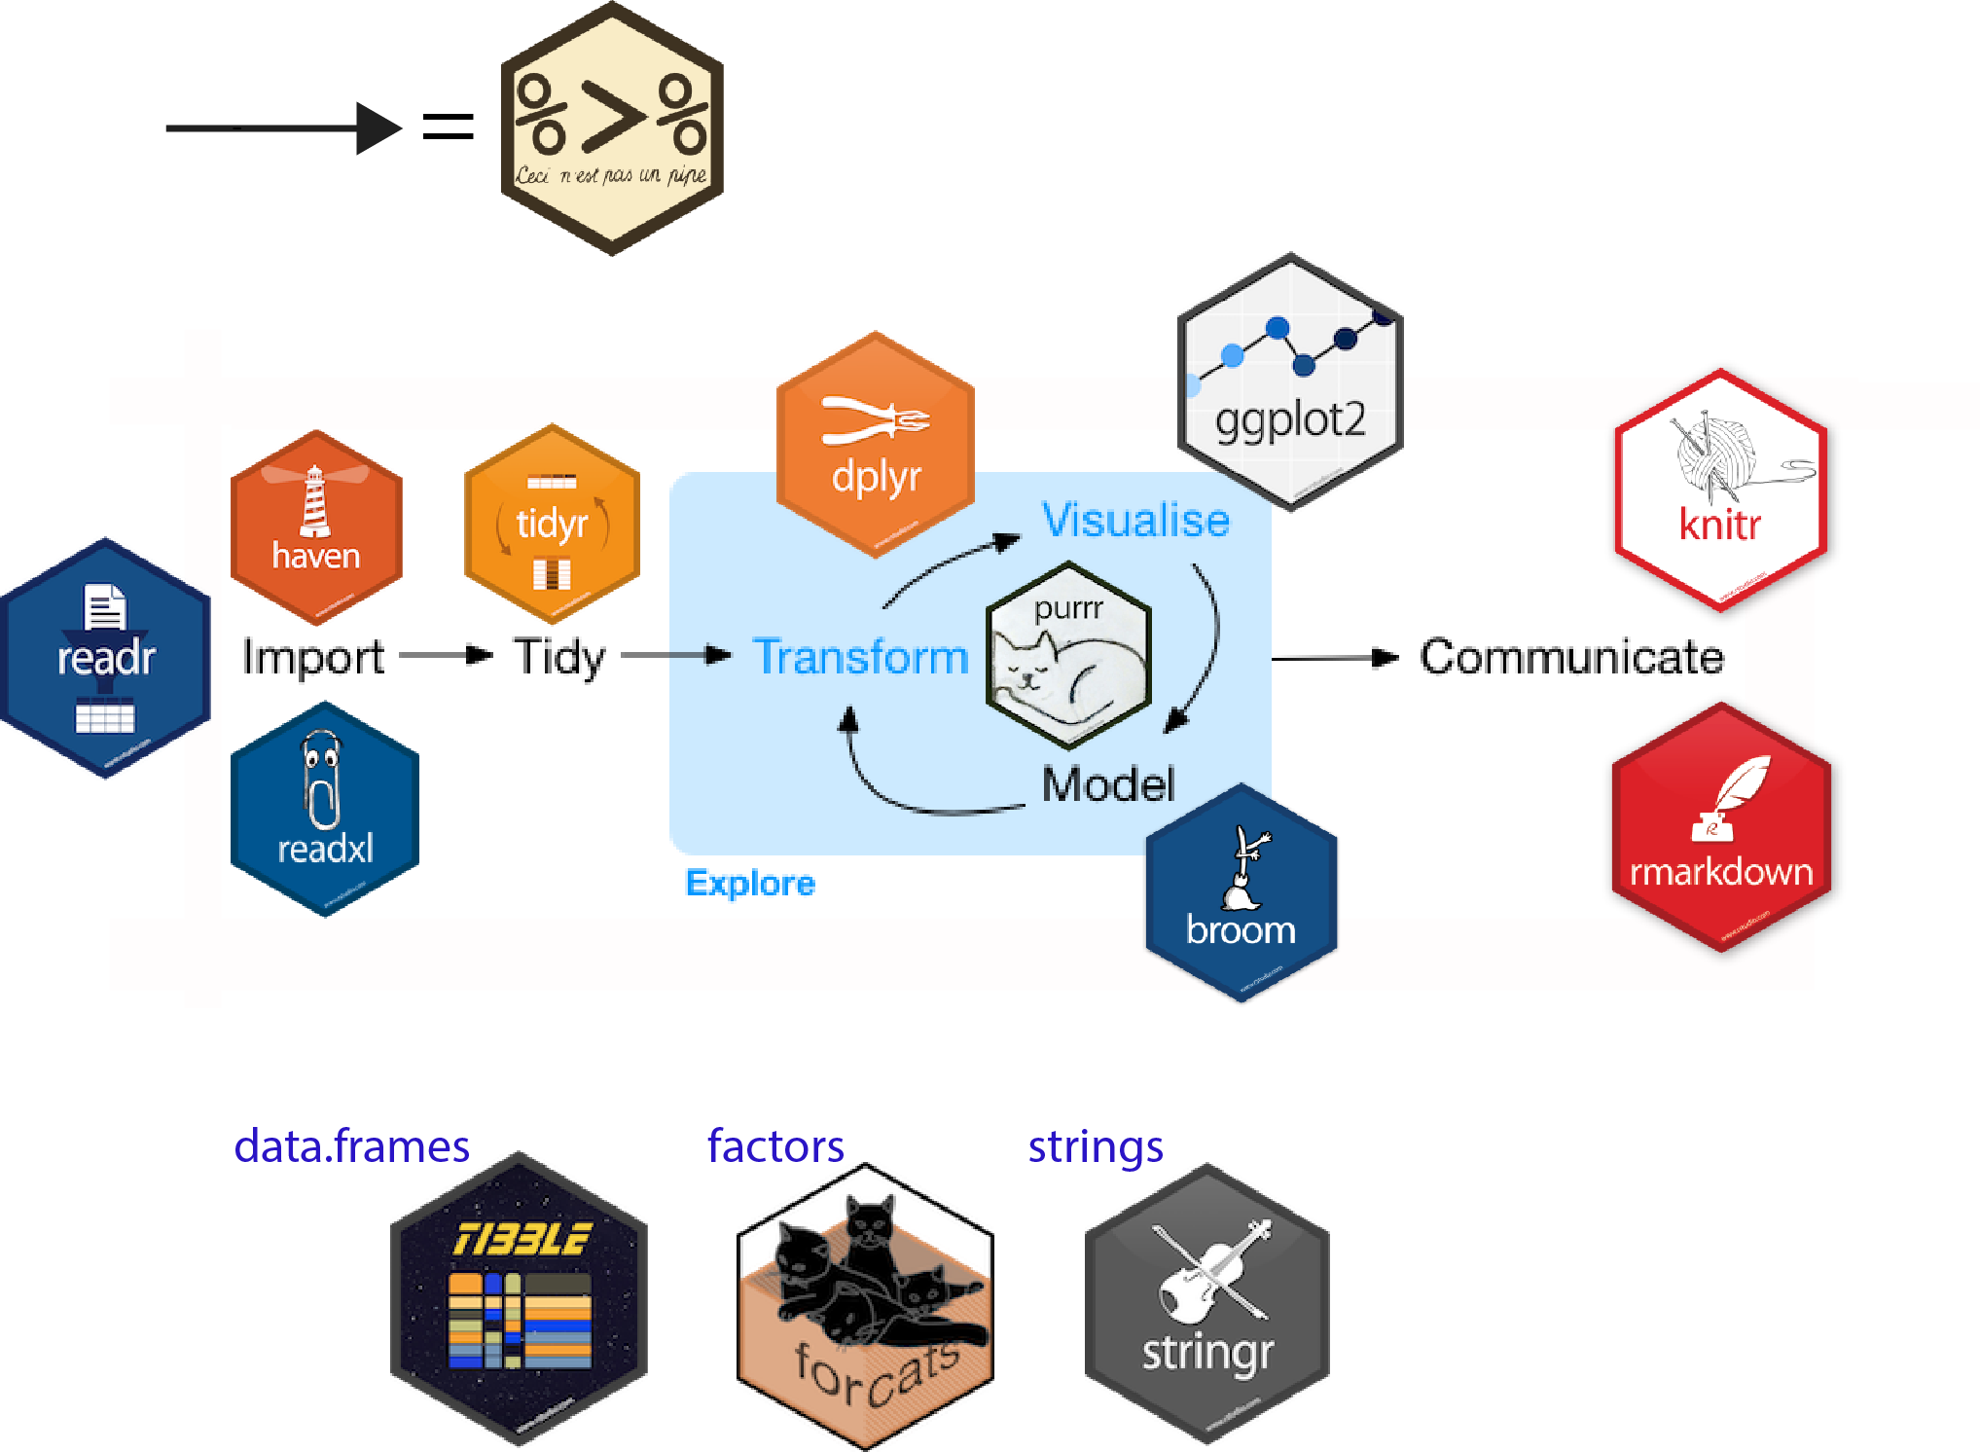
Other essential tools we will use
R packages
tidyverse
dplyr
…
easystats
datawizard
…
ggplot2
ggformula
gtsummary
…

Slide 28
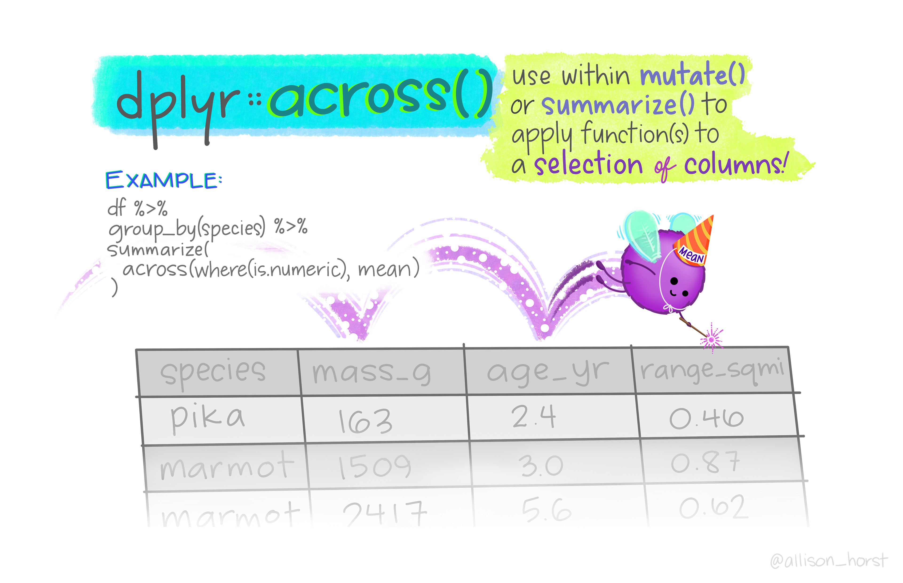
Other essential tools we will use
R packages
tidyverse
dplyr
…
easystats
datawizard
…
ggplot2
ggformula
gtsummary
…

Slide 29
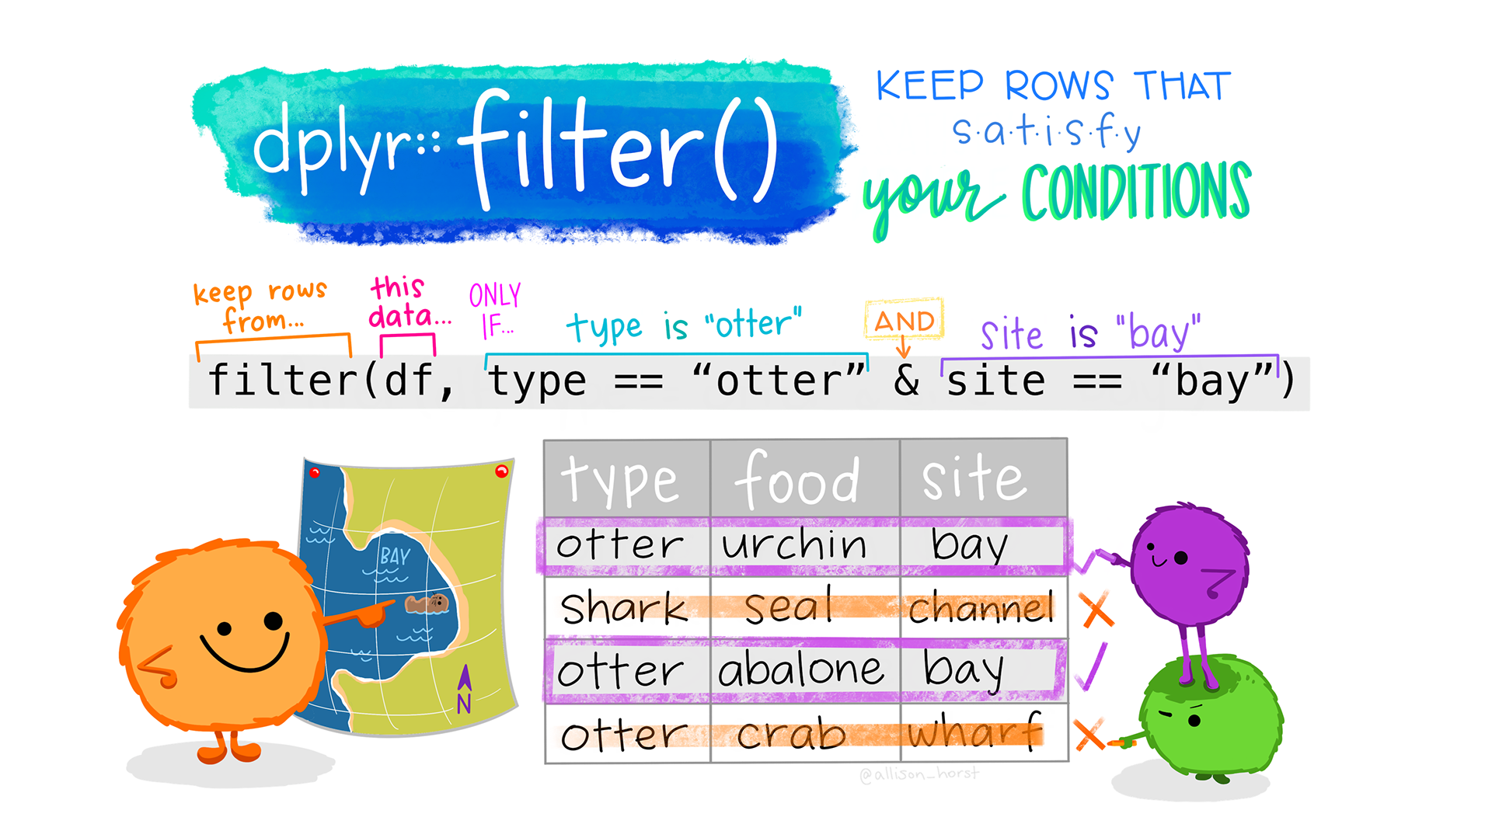
Other essential tools we will use
R packages
tidyverse
dplyr
…
easystats
datawizard
…
ggplot2
ggformula
gtsummary
…

Slide 30
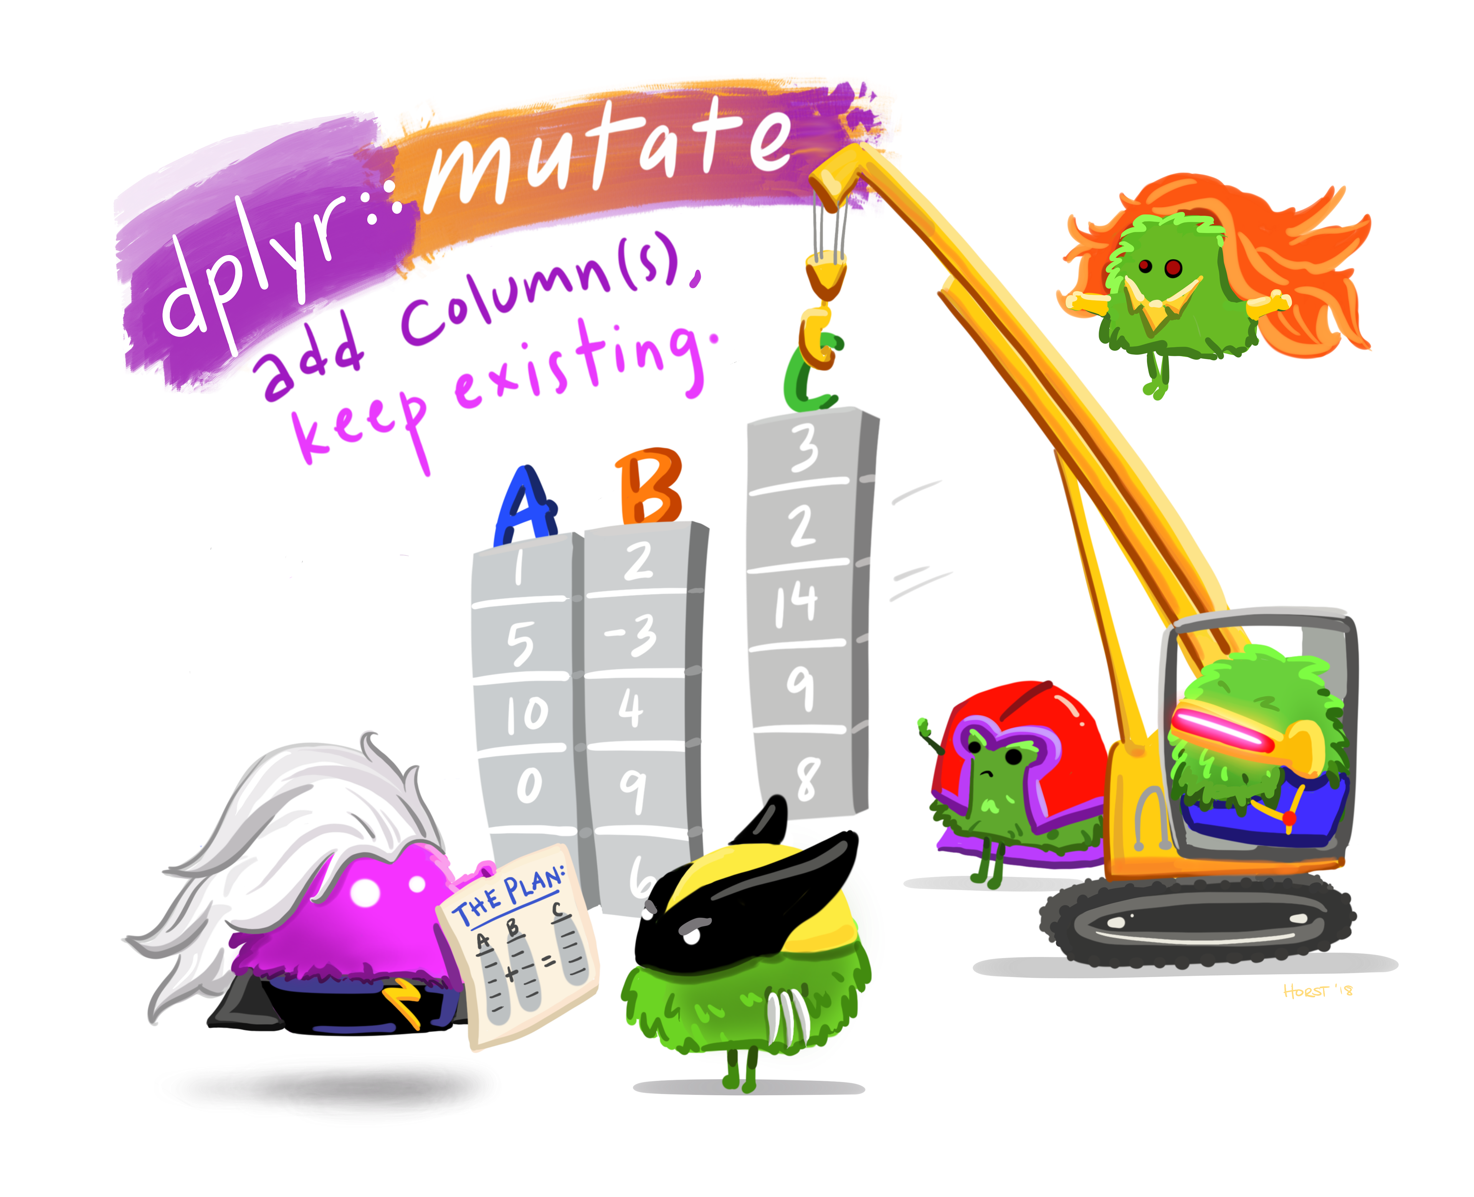
Other essential tools we will use
R packages
tidyverse
dplyr
…
easystats
datawizard
…
ggplot2
ggformula
gtsummary
…

Slide 31
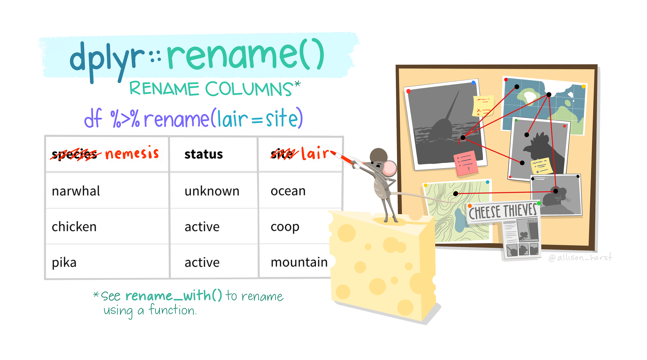
Other essential tools we will use
R packages
tidyverse
dplyr
…
easystats
datawizard
…
ggplot2
ggformula
gtsummary
…

Slide 32
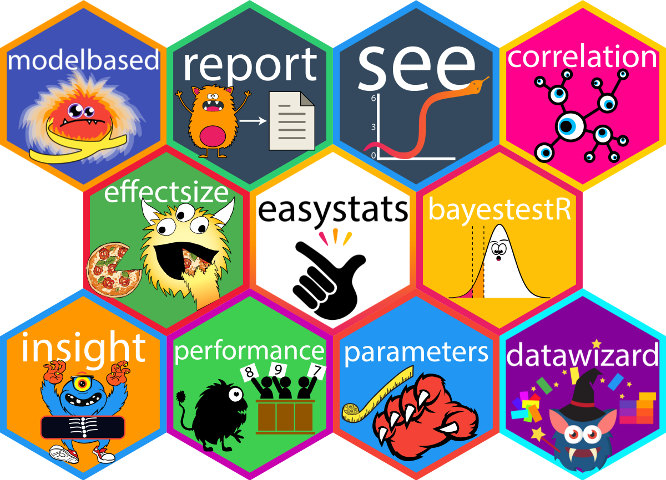
Other essential tools we will use
R packages
tidyverse
dplyr
…
easystats
datawizard
…
ggplot2
ggformula
gtsummary
…

Slide 33
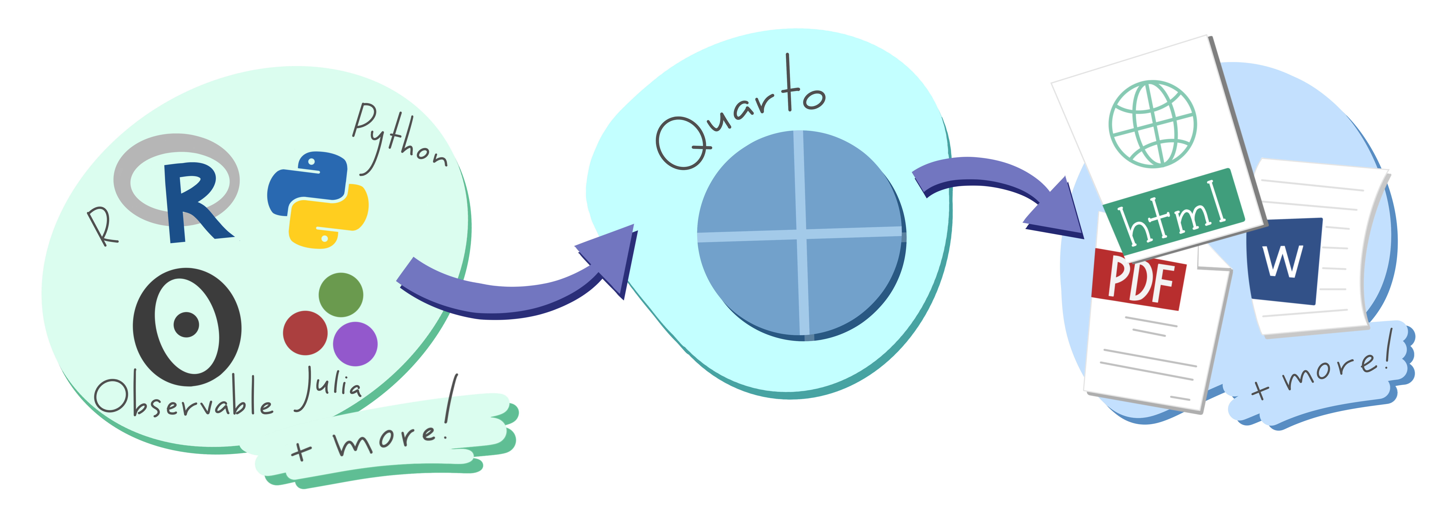
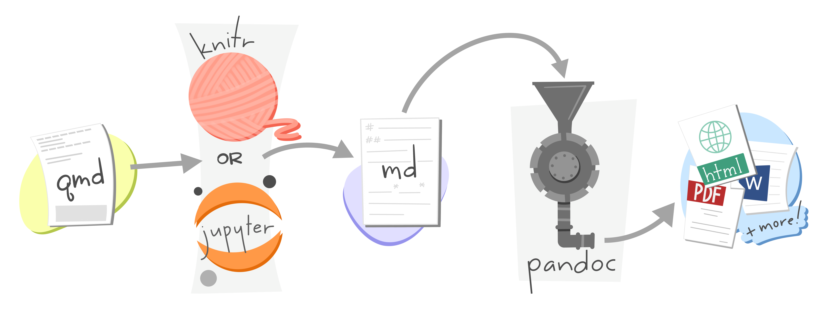
Other essential tools we will use
R Markdown / Quarto

Slide 34
Measurement: from questionnaire items to dataset variables

Slide 35
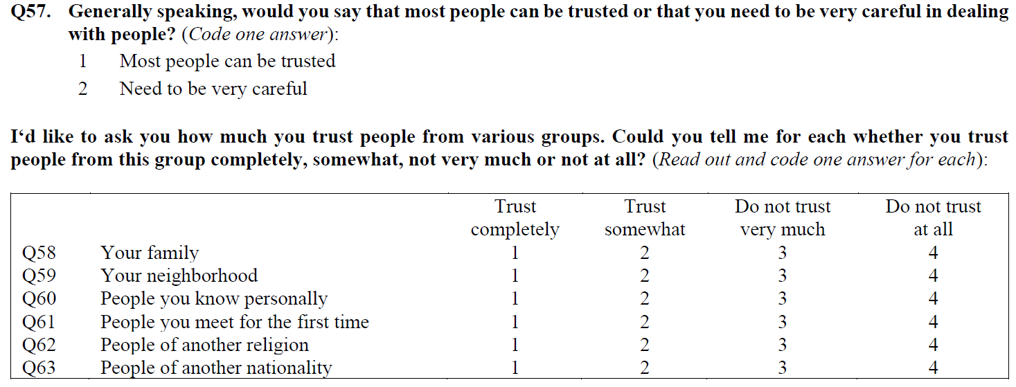
Questionnaire items

Slide 36
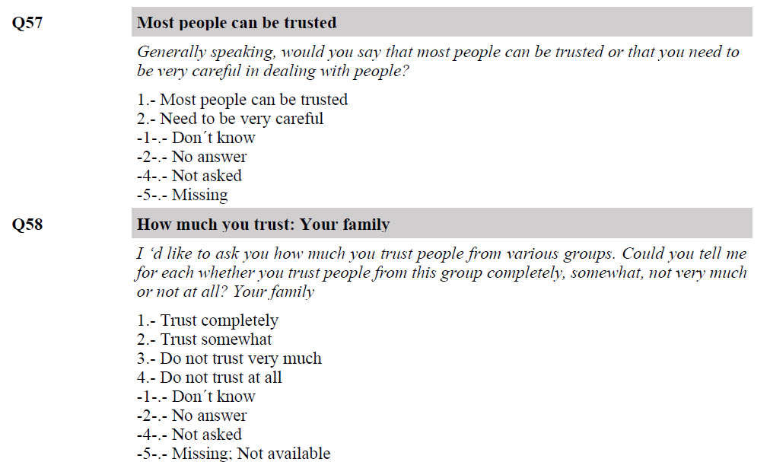
Variables in datasets

Slide 37
Variables vs. constants
“Lives in Newcastle” (Yes/No)
“Lives in the UK” (Yes/No)
“Lives on planet Earth” (Yes/No)

Slide 38
More on variables: types
Data
Numerical
(Quantitative)
Categorical
(Qualitative)
e.g. age weight, number of children, shoe size
e.g. Eye colour, gender, blood type, ethnicity

Slide 39
Measurement levels: what are they?
Data
Numerical
(Quantitative)
Categorical
(Qualitative)
Ratio
Interval
Ordinal, categories you can rank
Nominal, categories without order or direction
Dichotomous
(binary or dummy)
Polytomous
Height, weight, age, income
Temperature
e.g. educational attainment, satisfaction
e.g. gender
Marital status

Slide 40
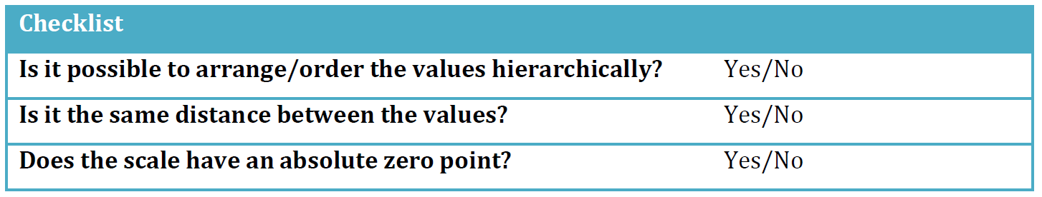
2. Measurement levels: how to identify them?
Notes:
What does “arrange/order the values hierarchically” mean? If we take gender as an example, it is not reasonable to say that “Man” is less or more than “Woman”. As another example, we can take ethnicity: it is not reasonable to see “English” as less or more than “French”. For variables such as self-rated health, on the other hand, it is possible to say that “Excellent health” is better than “Good health”. Moreover, it is possible to say that a 2:1 grade is better than a 2:2.
What does “distance” mean? If we take income as an example, we know that 1000 dollars are twice as much as 500 dollars, and 2000 dollars are twice as much as 1000 dollars. The same logic applies to variables such as age: it is the same distance between 2 years and 4 years as between 6 years and 8 years. Thus, having the same distance between the values means that the differences between two values are the same regardless of which part of the scale you are looking at.
What does “absolute zero point” mean? Basically, it means that the scale cannot have negative values. It is possible for the temperature to be minus 10 degrees Celsius, but is not possible to have less than zero years of schooling or having less than zero days of unemployment.

Slide 41
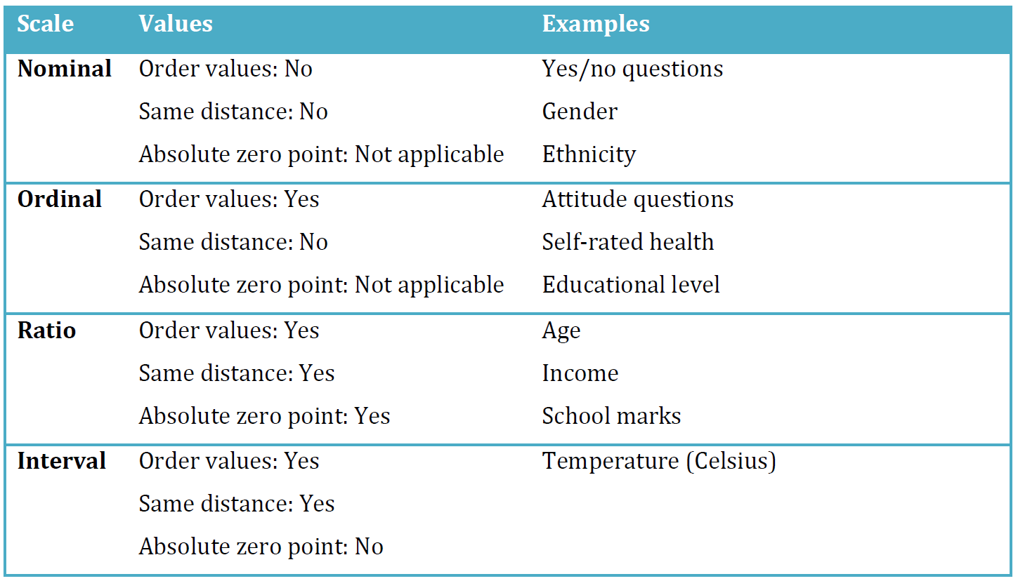
2. Measurement levels: how to identify them?
Notes:
Additional point: Values can also be of two kinds: ‘discrete’ and ‘continuous’.
Discrete values can only assume “whole” values, such as “Man”, “Women”, “Green”, “Car”, and “House”. Continuous values can assume any value along a scale, such as “3.5 years”, “58.3 seconds”, and “163.5 centimetres”. Note, however, that continuous variables (i.e. on a ratio or interval scale) do not necessarily have continuous values. For example, number of cars is a ratio variable but it has discrete values: while the average number of cars in a population may be 0.8, it is not correct to say that any given individual in a population has 0.8 cars (since a car is a “whole” value”).

Slide 42
An additional point: values
Values can also be:
Even when the variables that contain them are continuous:
Discrete
Continuous
e.g. think of: number of cars on the road
e.g. height, weight, age income
Notes:
Additional point: Values can also be of two kinds: ‘discrete’ and ‘continuous’.
Discrete values can only assume “whole” values, such as “Man”, “Women”, “Green”, “Car”, and “House”. Continuous values can assume any value along a scale, such as “3.5 years”, “58.3 seconds”, and “163.5 centimetres”. Note, however, that continuous variables (i.e. on a ratio or interval scale) do not necessarily have continuous values. For example, number of cars is a ratio variable but it has discrete values: while the average number of cars in a population may be 0.8, it is not correct to say that any given individual in a population has 0.8 cars (since a car is a “whole” value”).

Slide 43
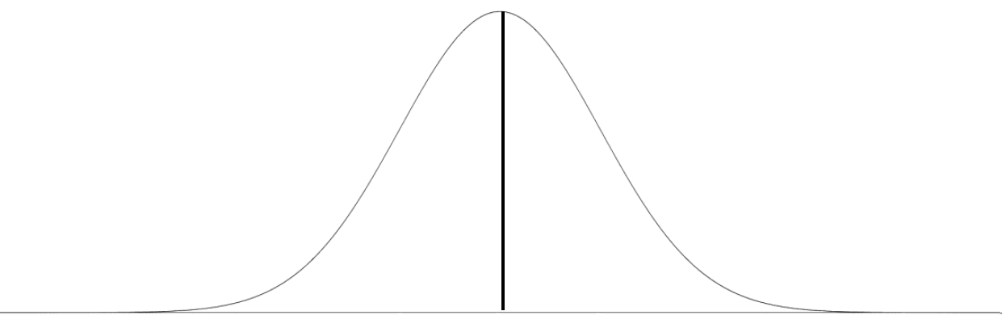
Distributions
The ‘normal distribution’
Bell-shaped
The peak indicates the mean value
(mean means average, not malicious)
Symmetrical (the tails on each side of the mean are equally long)
Notes:
Always bell-shaped.
The peak always indicates the mean value.
Always symmetrical, i.e. the tails on each side of the mean are equally large. This means that 50 % of the values are on one side of the mean, and 50 % of the values are on the other side of the mean. The area under the curve is always 1 (100 % of the values).

Slide 44
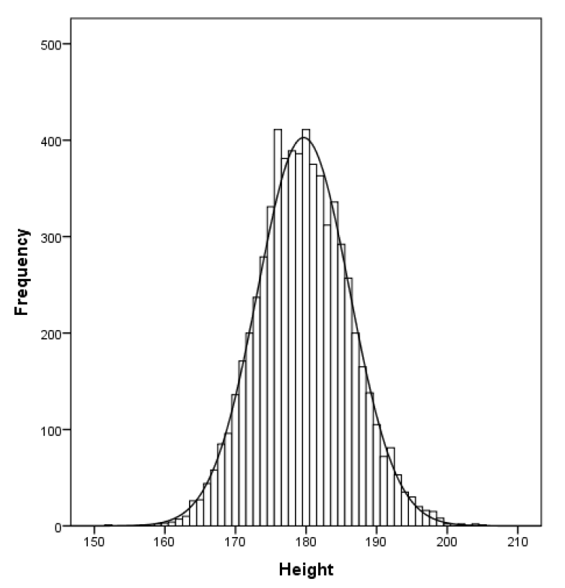
Distributions
The ‘normal distribution’
Is this a ‘normal distribution’?
Notes:
Always bell-shaped.
The peak always indicates the mean value.
Always symmetrical, i.e. the tails on each side of the mean are equally large. This means that 50 % of the values are on one side of the mean, and 50 % of the values are on the other side of the mean. The area under the curve is always 1 (100 % of the values).

Slide 45
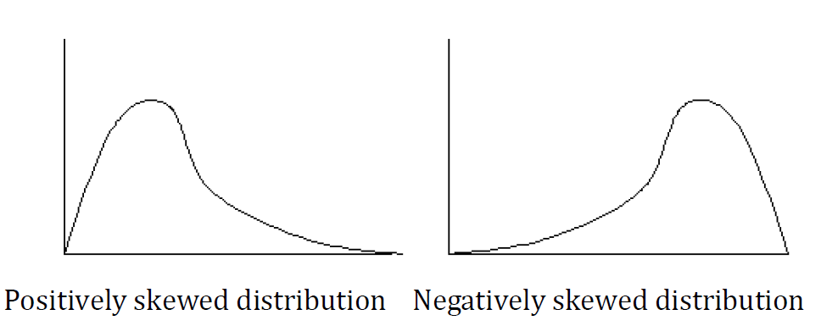
Distributions
Skewed distributions
Notes:
Always asymmetrical = tails are different, i.e. the empirical rule does not apply
Skew can be positive (right tail longer) or negative (left tail longer).
Measure of the symmetry of a distribution.
Negative skewness value = the distribution is skewed to the right (longer tail to the right)
Positive skewness value = the distribution is skewed to the left (longer tail to the left)
A perfect normal distribution has a skewness of 0
Skewness value between -2 and +2 is usually considered acceptable

Slide 46
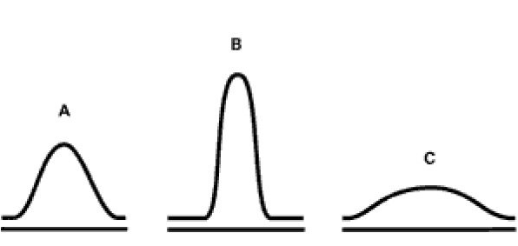
3. Distributions
Skewed distributions
A: Mesokurtic
(a perfect normal distribution; kurtosis value = 0)
B: Leptokurtic
(Kurtosis > 0; sharp peak, long tails)
C: Platykurtic
(Kurtosis < 0; flat/round peak, short tail)
Notes:
Measure of the shape (or the “peakedness”) of a distribution
A perfect normal distribution has a kurtosis of 0 (mesokurtic distribution)
Kurtosis value above 0 = Leptokurtic distribution (sharper peak and longer/fatter tails)
Kurtosis value below 0 = Platykurtic distribution (rounder peak and shorter/thinner tails)
Kurtosis value between -2 and +2 is usually considered acceptable

Slide 47
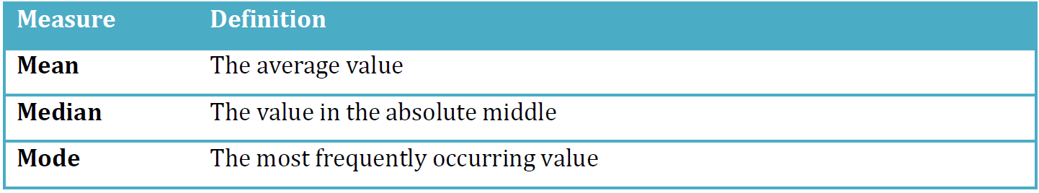
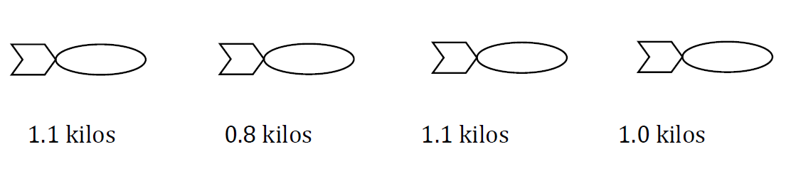
Measures of central tendency
Example 1: Mean
1. Add values together
2. Divide sum by number of values
+ + + = 4
4/(1+1+1+1)=1 => Mean = 1 kilo
Notes:
Central tendency can be defined as measures of the location of the middle in a distribution.

Slide 48
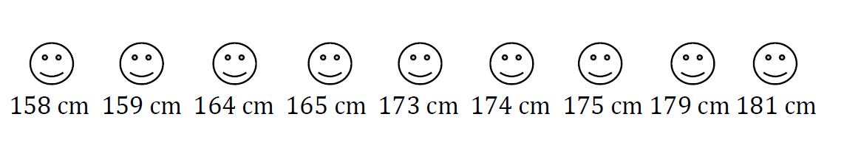
Measures of central tendency
Example 2: Median
Sort values from low to high and then identifying the value in the middle
Notes:
The median is the value in the absolute middle of the distribution. We sort all the values from low to high and then identifying the value in the middle of the list.
Media here is 173 cm.

Slide 49
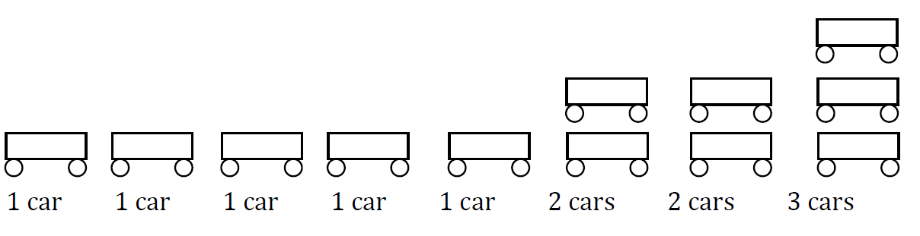
Measures of central tendency
Example 2: Mode
It’s the most frequently occurring value in a distribution.
Notes:
The mode - or “type” - is defined as the most frequently occurring value in a distribution: here 1.

Slide 50
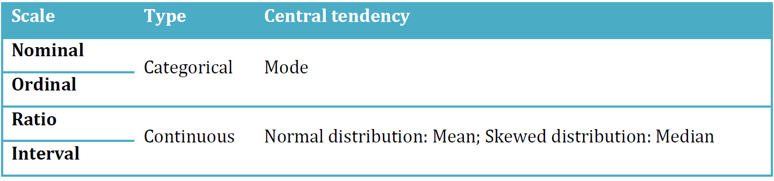
Measures of central tendency

Slide 51
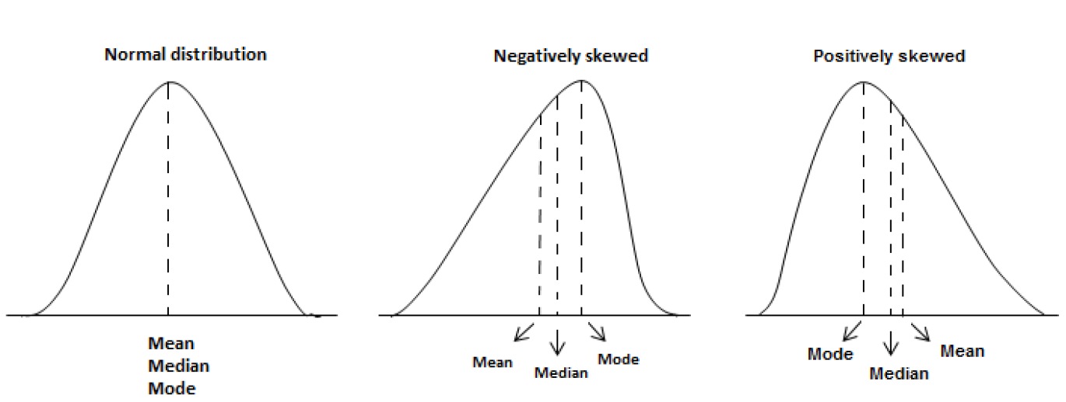
Measures of central tendency

Slide 52
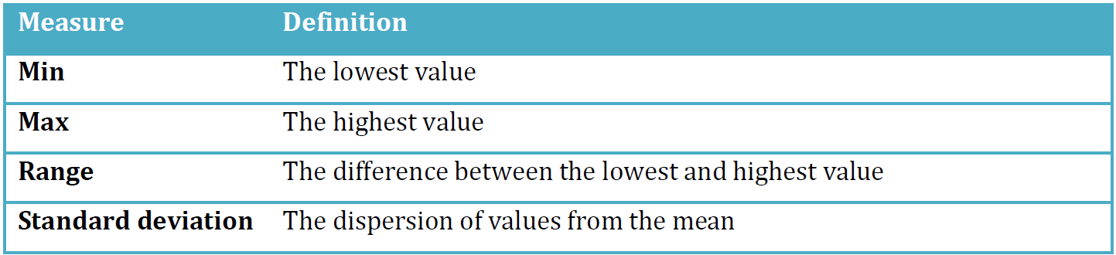
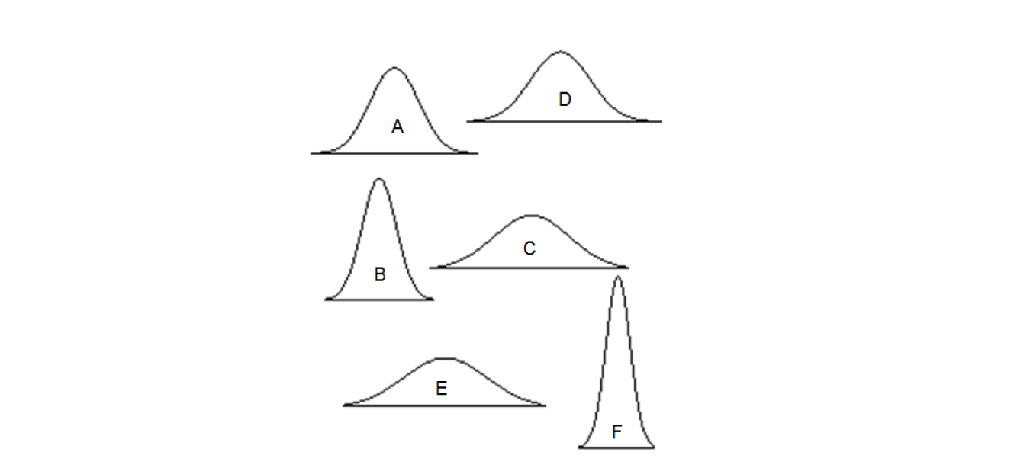
Measures of variation
Notes:
These measures are most suitable for continuous variables (i.e. ratio or interval) but sometimes min, max, and range are used for ordinal variables as well. However, they cannot be used for nominal variables (for the same reason as why we do not use mean or median to describe nominal variables).

Slide 53
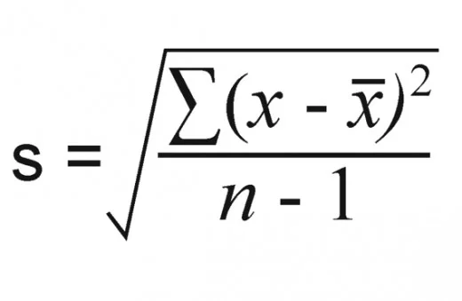
Measures of variation: the Standard Deviation
The sample (!) SD expresses how much variation exists from the mean for a given variable
“The standard deviation is a measure of volatility that measures the amount of variability or volatility around the mean. The standard deviation is large if there is high volatility in the data and low if the data is closely clustered around the mean. In other words, the smaller the standard deviation, the less “error” we have in our data and the more secure we can be in knowing that our sample mean closely matches our population mean” (Stockemer 2019: 92)
where xi is each value is the data set, x-bar is the mean, and n is the number of values in the data set
Notes:
The difference lies in the amount of spread of the values: because the shape of a normal distribution is not only defined by the mean value, but by the standard deviation!
But what is “standard deviation”? A simple definition is that it expresses how much variation exists from the mean for a given variable. If we have a low standard deviation, it suggests that the individuals in our data have values close to the mean, and if we have a high standard deviation, it indicates that the values are more spread out over a large range of values.

Slide 54
Measures of variation: the Standard Deviation
The Standard Deviation:
1. Mean: the average of the numbers
2. Case deviations (Residuals): subtract the mean from each number
3. Variance: square each of the differences, add them up to get the sum of squares, and divide the sum of squares by the number of cases minus one
4. SD: take the square root of the variance
where xi is each value is the data set, x-bar is the mean, and n is the number of values in the data set
Notes:
The difference lies in the amount of spread of the values: because the shape of a normal distribution is not only defined by the mean value, but by the standard deviation!
But what is “standard deviation”? A simple definition is that it expresses how much variation exists from the mean for a given variable. If we have a low standard deviation, it suggests that the individuals in our data have values close to the mean, and if we have a high standard deviation, it indicates that the values are more spread out over a large range of values.

Slide 55
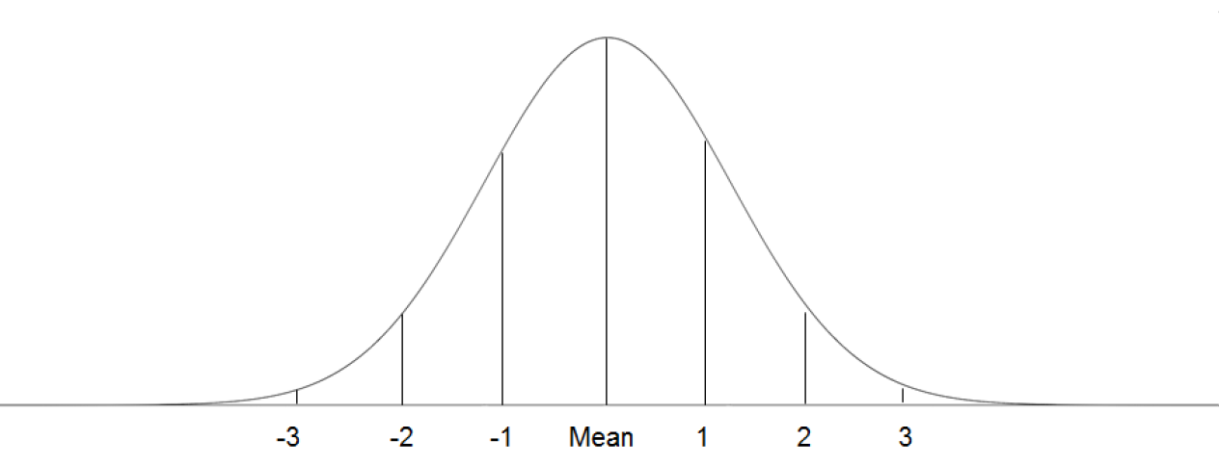
Measures of variation: the Standard Deviation
Standard deviation in a normal distribution
68%
95%
99.7%
Notes:
The difference lies in the amount of spread of the values: because the shape of a normal distribution is not only defined by the mean value, but by the standard deviation!
But what is “standard deviation”? A simple definition is that it expresses how much variation exists from the mean for a given variable. If we have a low standard deviation, it suggests that the individuals in our data have values close to the mean, and if we have a high standard deviation, it indicates that the values are more spread out over a large range of values.
Empirically we observe that usually:
68 % of the values fall within -1 and +1 standard deviations.
95 % of all values fall within -2 and +2 standard deviations.
Nearly 100 % of all values fall within -3 and +3 standard deviations.

Slide 56
Understanding and describing (clean) data

Slide 57

Tidy data

Slide 58
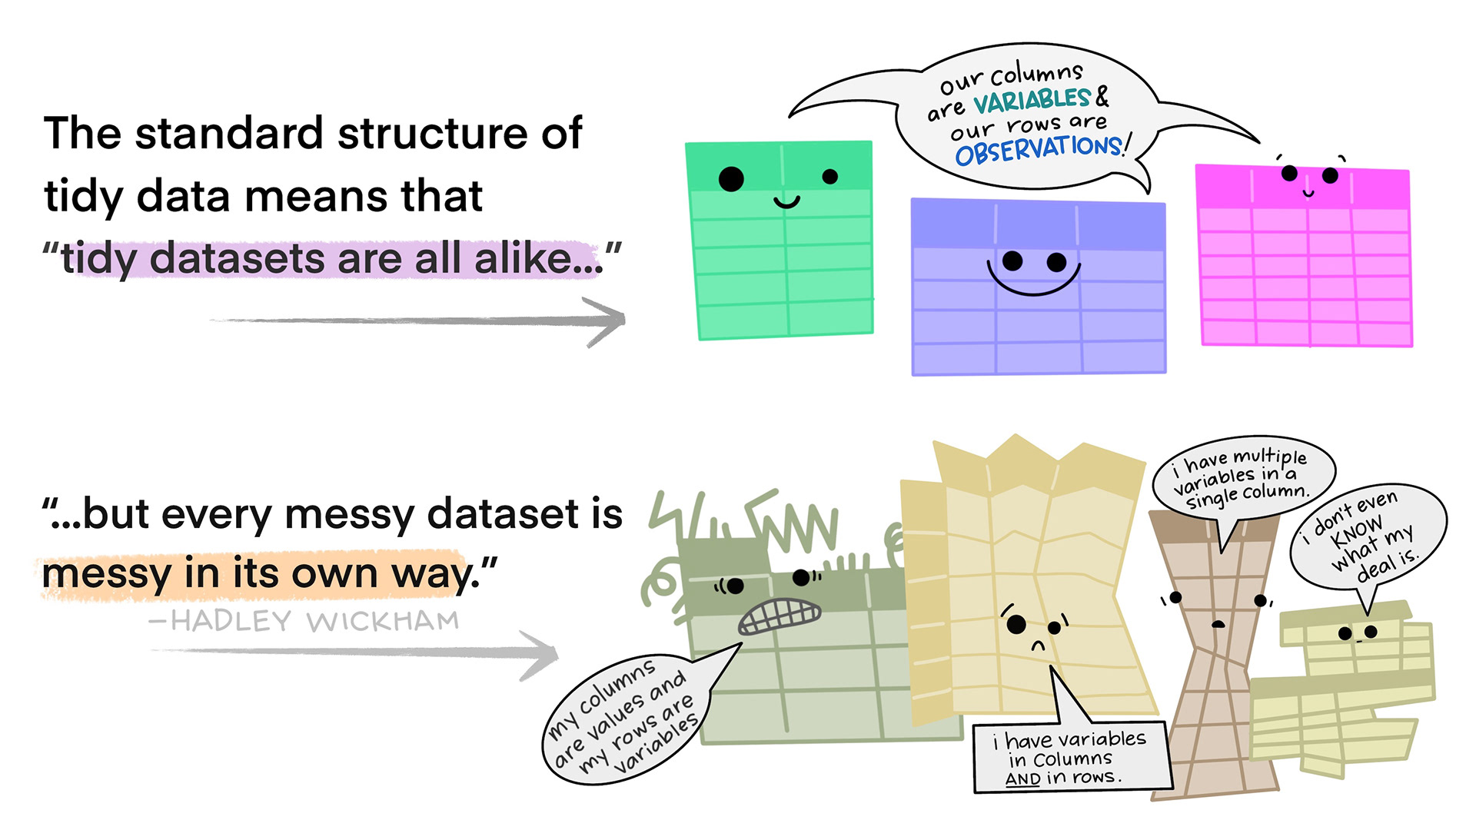
Tidy data

Slide 59
Visualisation

Slide 60
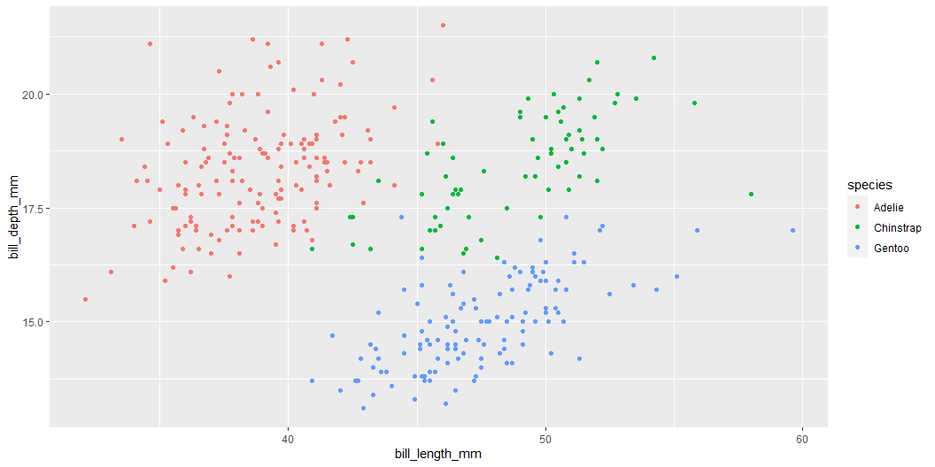
library(palmerpenguins) ggplot(penguins, aes(x = bill_length_mm, y = bill_depth_mm, color = species)) + geom_point()
Notes:
I may write a lot of extra stuff here in case you are interested.

Slide 61
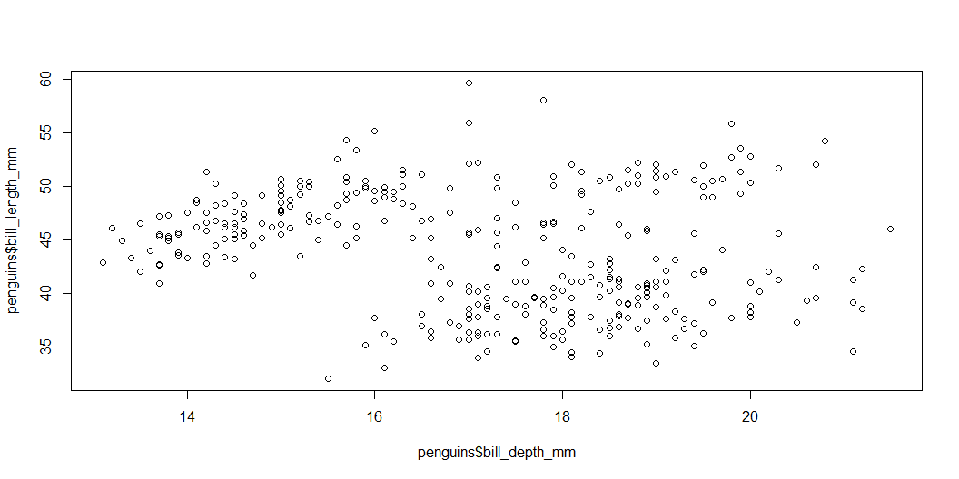
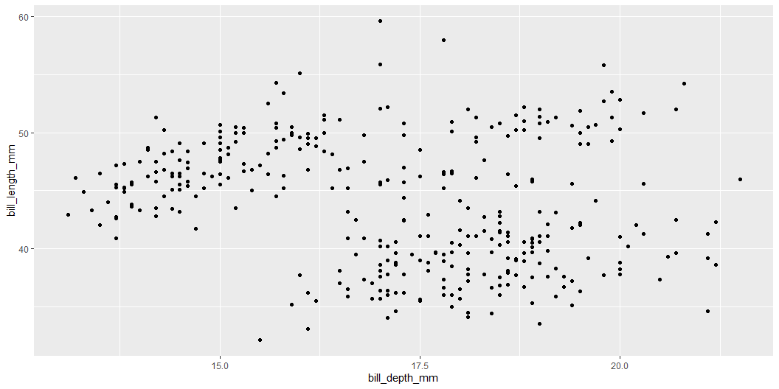
Base R vs. Tidyverse
plot(penguins$bill_depth_mm, penguins$bill_length_mm)
ggplot(penguins, aes(bill_depth_mm, bill_length_mm)) + geom_point()

Slide 62
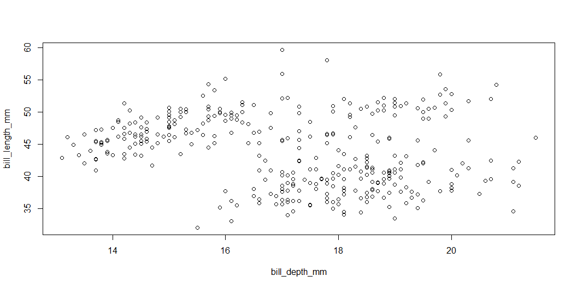
Using with() in base R
with(penguins, plot(bill_depth_mm, bill_length_mm))
ggplot(penguins, aes(bill_depth_mm, bill_length_mm)) + geom_point()

Slide 63
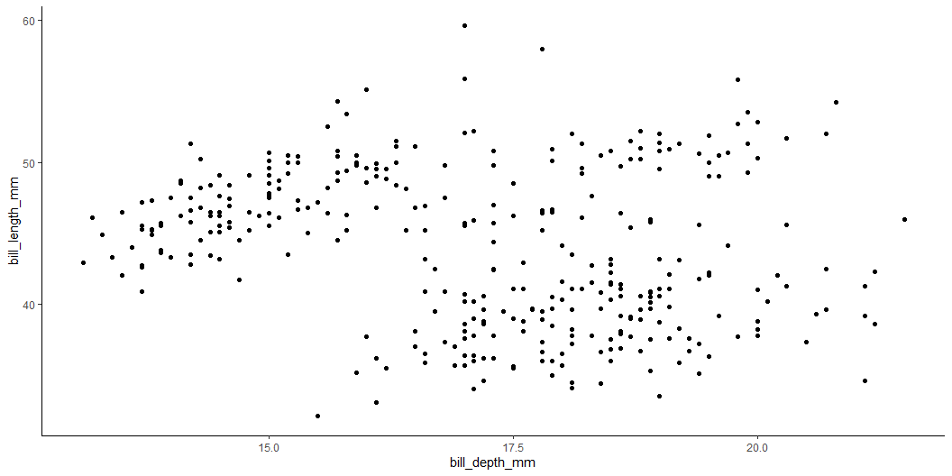
Changing the ggplot theme
with(penguins, plot(bill_depth_mm, bill_length_mm))
ggplot(penguins, aes(bill_depth_mm, bill_length_mm)) + geom_point() + theme_classic()

Slide 64
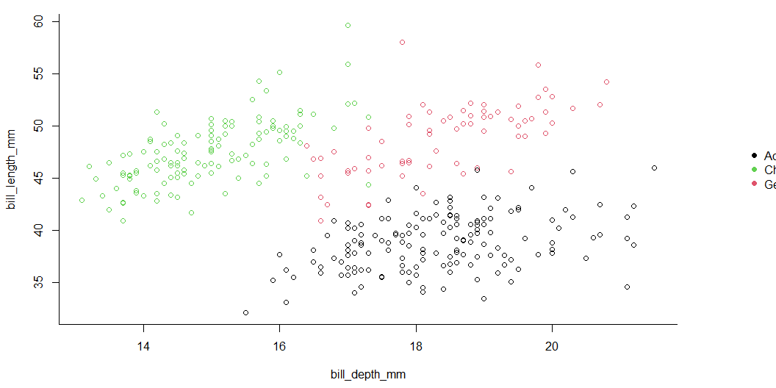
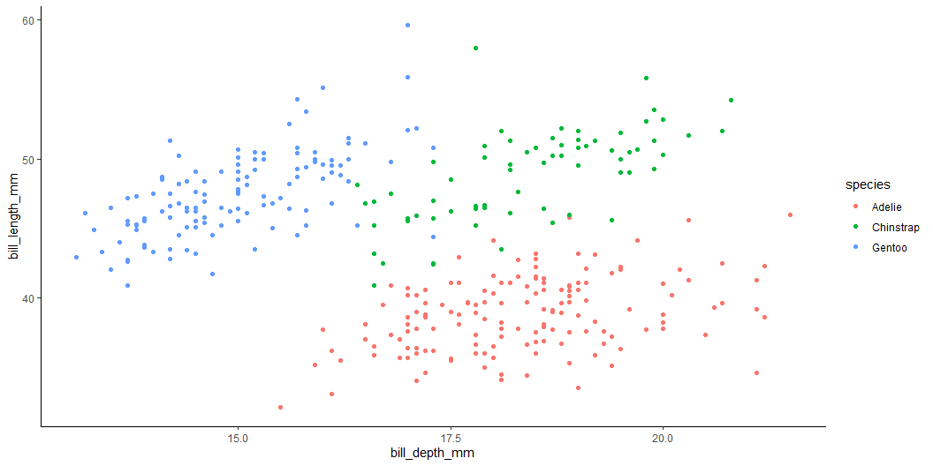
Some further styling options
par(mar=c(4.5, 4.2, 1, 7), xpd=TRUE) # set custom plot size with(penguins, # select data frame plot(bill_depth_mm, # select variables to plot bill_length_mm, col = species, # grouping colour bty = "L") # change plot border style ) with(penguins, legend("right", # legend position inset=c(-0.23,0.5), # legend custom location (outside the plot) legend = levels(species), # legend labels pch = 16, # legend symbol size col = unique(species), # legend symbol colour bty = "n" # remove legend borders ) )
ggplot(penguins, # draw empty canvas aes(bill_depth_mm, # select variables to plot bill_length_mm, color = species)) + # grouping colour geom_point() + # select plot type theme_classic() # select pre-set style settings (theme)

Slide 65
Enjoy the labs!

